Slide 1
React Web Applications Master Class
Apollo GraphQL
SoftUni Team
Technical Trainers
Software University
http://softuni.bg

Slide 2
Table of Contents
Apollo GraphQL Platform
Apollo Client

Slide 3



Learn to Search in Internet
The course assignments require to search in Internet
This is an important part of the learning process
Some exercises intentionally have no hints
Learn to find solutions!
Software development includes everyday searching and learning
No excuses, just learn to study!
Developers learn new technologies, tools, languages every day!

Slide 4
Apollo GraphQL Platform

Slide 5
Apollo Mission
Our company is focused on making application development easier, better, and accessible to more people. We build open source tools and commercial services used by many thousands of developers in production.*

Slide 6
Apollo GraphQL Platform
Apollo is an implementation of GraphQL designed for the needs of product engineering teams building modern, data-driven applications.*

Slide 7
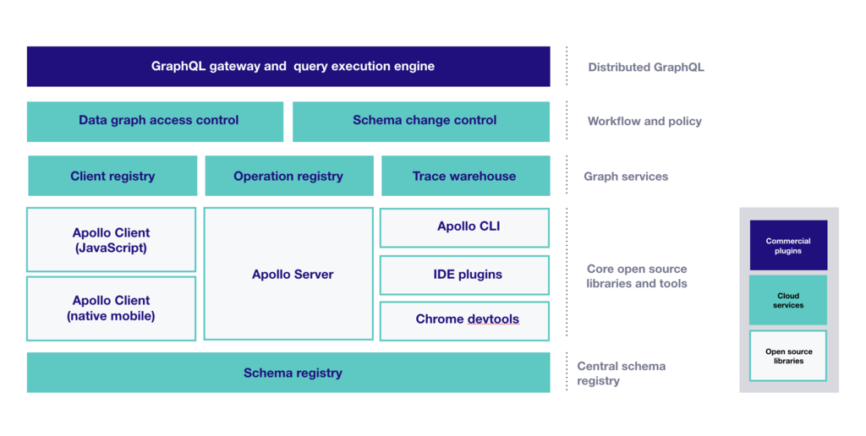
Apollo GraphQL Platform
A layer that sits between your services and your applications.*

Slide 8
Core Components*
Apollo Server
Apollo Client
Apollo CLI
A simple command line client that provides access to Apollo cloud services.

Slide 9
Apollo Server

Slide 10
Apollo Server
Apollo Server is JavaScript GraphQL server for defining a schema and a set of resolvers that implement each part of that schema.

Slide 11
Apollo Server
Works as:
a stand-alone server
an addon to Node.js Http Server
in serverless environment
GraphQL Spec-Compliant
Consumer-Agnostic

Slide 12
Creating Apollo Server Steps*
Install Dependencies
Build GraphQL Schema
Define Resolvers
Create Apollo Server Instance
Run the Server

Slide 13
DEMO

Slide 14
Apollo Client

Slide 15
Apollo Client
Apollo Client is a sophisticated GraphQL client that manages data and state in an application.

Slide 16
Apollo Client Features
Declarative data fetching
Excellent developer experience
Incrementally adoptable
Universally compatible
Community driven

Slide 17
Supported Platforms
JavaScript
React
Angular
Vue
Meteor
Ember
Web Components
Apollo Elements
Native mobile
Native iOS with Swift
Native Android with Java

Slide 18
Apollo Boost

Slide 19
What is Apollo Boost?
A npm library allowing you to quickly start using and configure an Apollo Client by including essential packages and configuring recommended settings.

Slide 20
Apollo Boost
Install Dependencies
Create Instance of ApolloClient
Fetch Data

Slide 21
DEMO

Slide 22
Apollo-Boost Components
apollo-client
apollo-cache-inmemory
apollo-link-http
apollo-link-error

Slide 23
Apollo Client InMemoryCache

Slide 24
Apollo InMemoryCache
Normalized Data Store
No Redux Dependency
Optimizes execution of queries

Slide 25
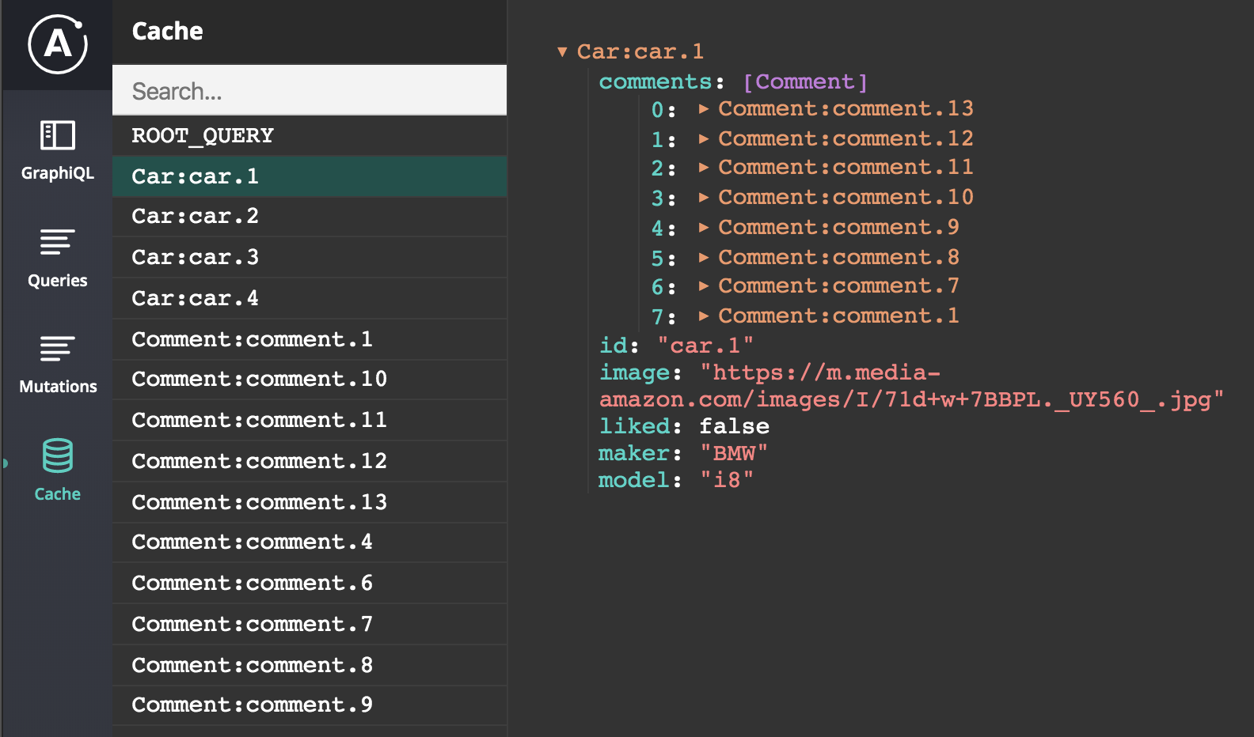
Data Normalization
Splitting the results into individual objects
Assigning a unique identifier to each object
Storing the objects in a flattened data structure

Slide 26
Apollo Link

Slide 27
What are Apollo Links
Apollo Links are chainable "units" that you can snap together to define how each GraphQL request is handled by your GraphQL client

Slide 28

Apollo Link
Apollo Link is a function that takes an operation and returns an observable
operation signature:
query - a DocumentNode (parsed GraphQL Operation) describing the operation taking place
variables - map of variables being sent with the operation
operationName - A string name of the query if it is named, otherwise it is null

Slide 29
Apollo Link - Key Concepts
Request - the core method of a link, takes two arguments:
operation - the operation being passed through the link
forward - specifies the next link in the chain of links
Terminating Links - such that doesn’t invoke forward.
Composition - links are designed to be composed together to form control flow chains to manage a GraphQL operation request
Context - metadata attached to the operation allowing links to “communicate” (share data) with each other

Slide 30

Apollo Link
Links can be used as:
middleware - perform side effects, modify the operation, or even just provide developer tools like logging
afterware - process the result of an operation, handle errors, or even save the data to multiple locations

Slide 31
Apollo Client Fetching Data

Slide 32
Query
useQuery - primary API for executing GraphQL queries
Caching - by default all queries results are cached
fetchPolicy: cache-first, cache-and-network, network-only, cache-only, no-cache
Polling - executes query at specified intervals
Refetch - allows you to execute the same query on demand
Pagination - allows you fetch paginated data
Fragments - shared piece of query logic.

Slide 33
DEMO

Slide 34
Mutation
useMutation - primary API for executing GraphQL mutations
Client Updates
updates on in cache object with id are handled by ApolloClient
otherwise you should update manually
Optimistic Response - simulate the results of a mutation and update the UI before receiving a response from the server

Slide 35
Local State Management
Apollo Client (>= 2.5) has built-in local state handling capabilities that allow you to store your local data inside the Apollo cache alongside your remote data.

Slide 36
Local State
Getting Local State
direct read
useQuery
Updating Local State
direct writes
local resolvers
Client-Side Schema

Slide 37
DEMO

Slide 38
Subscriptions
GraphQL subscriptions are a way to push data from the server to the clients that choose to listen to real time messages from the server.

Slide 39
Subscriptions
Install Dependencies
apollo-link-ws
subscriptions-transport-ws
Initialize Subscription Link
useSubscription - lets you subscribe for GraphQL subscription

Slide 40
DEMO

Slide 42






СофтУни диамантени партньори

Slide 43






СофтУни диамантени партньори

Slide 44





Trainings @ Software University (SoftUni)
Software University – High-Quality Education, Profession and Job for Software Developers
softuni.bg
Software University Foundation
http://softuni.foundation/
Software University @ Facebook
facebook.com/SoftwareUniversity
Software University Forums
forum.softuni.bg

